Slide 1

Static vs. Instance Methods
Static vs. Instance Methods
COMPLETE JAVA MASTERCLASS
Static vs Instance Methods

Slide 2
Static Methods
Static methods are declared using a static modifier.
Static methods can't access instance methods and instant variables directly.
They're usually used for operations that don't require any data from an instance of the class (from 'this').
If you remember, the this keyword is the current instance of a class.
COMPLETE JAVA MASTERCLASS
Static vs Instance Methods

Slide 3
Static Methods
So inside a static method, we can't use the this keyword.
Whenever you see a method that doesn't use instance variables, that method should probably be declared as a static method.
For example, main is a static method, and it's called by the Java virtual machine when it starts the Java application.
COMPLETE JAVA MASTERCLASS
Static vs Instance Methods

Slide 4
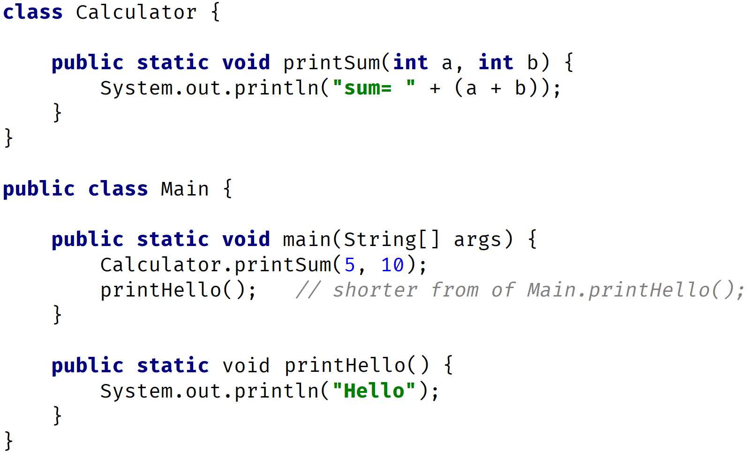
Static Methods Example
static methods are called as ClassName.methodName(); or methodName(); only if in the same class
In this example Calculator.printSum(5,10); printHello();
COMPLETE JAVA MASTERCLASS
Static vs Instance Methods

Slide 5
Instance Methods
Instance methods belong to an instance, of a class.
To use an instance method, we have to instantiate the class first, usually by using the new keyword.
COMPLETE JAVA MASTERCLASS
Static vs Instance Methods

Slide 6
Instance Methods
Instance methods can access instance methods and instance variables directly.
Instance methods can also access static methods and static variables directly.
COMPLETE JAVA MASTERCLASS
Static vs Instance Methods

Slide 7
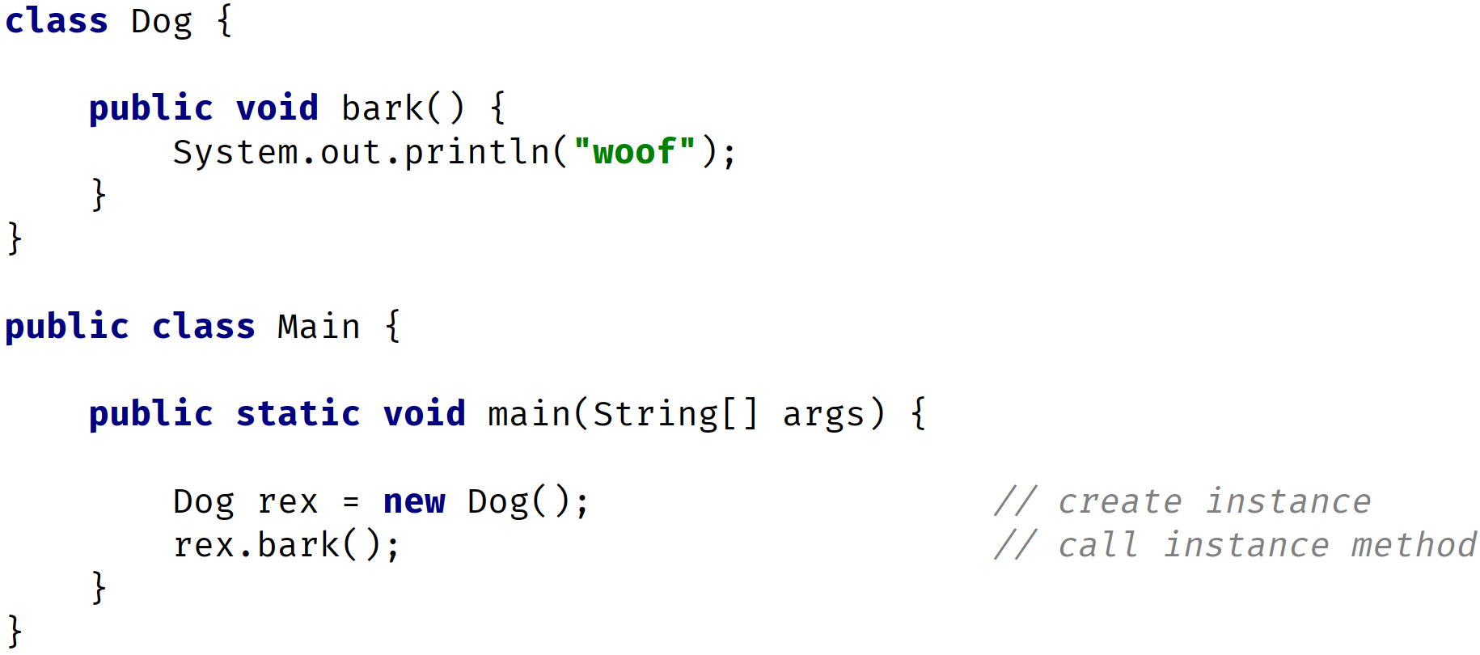
Instance Method Example
COMPLETE JAVA MASTERCLASS
Static vs Instance Methods

Slide 8
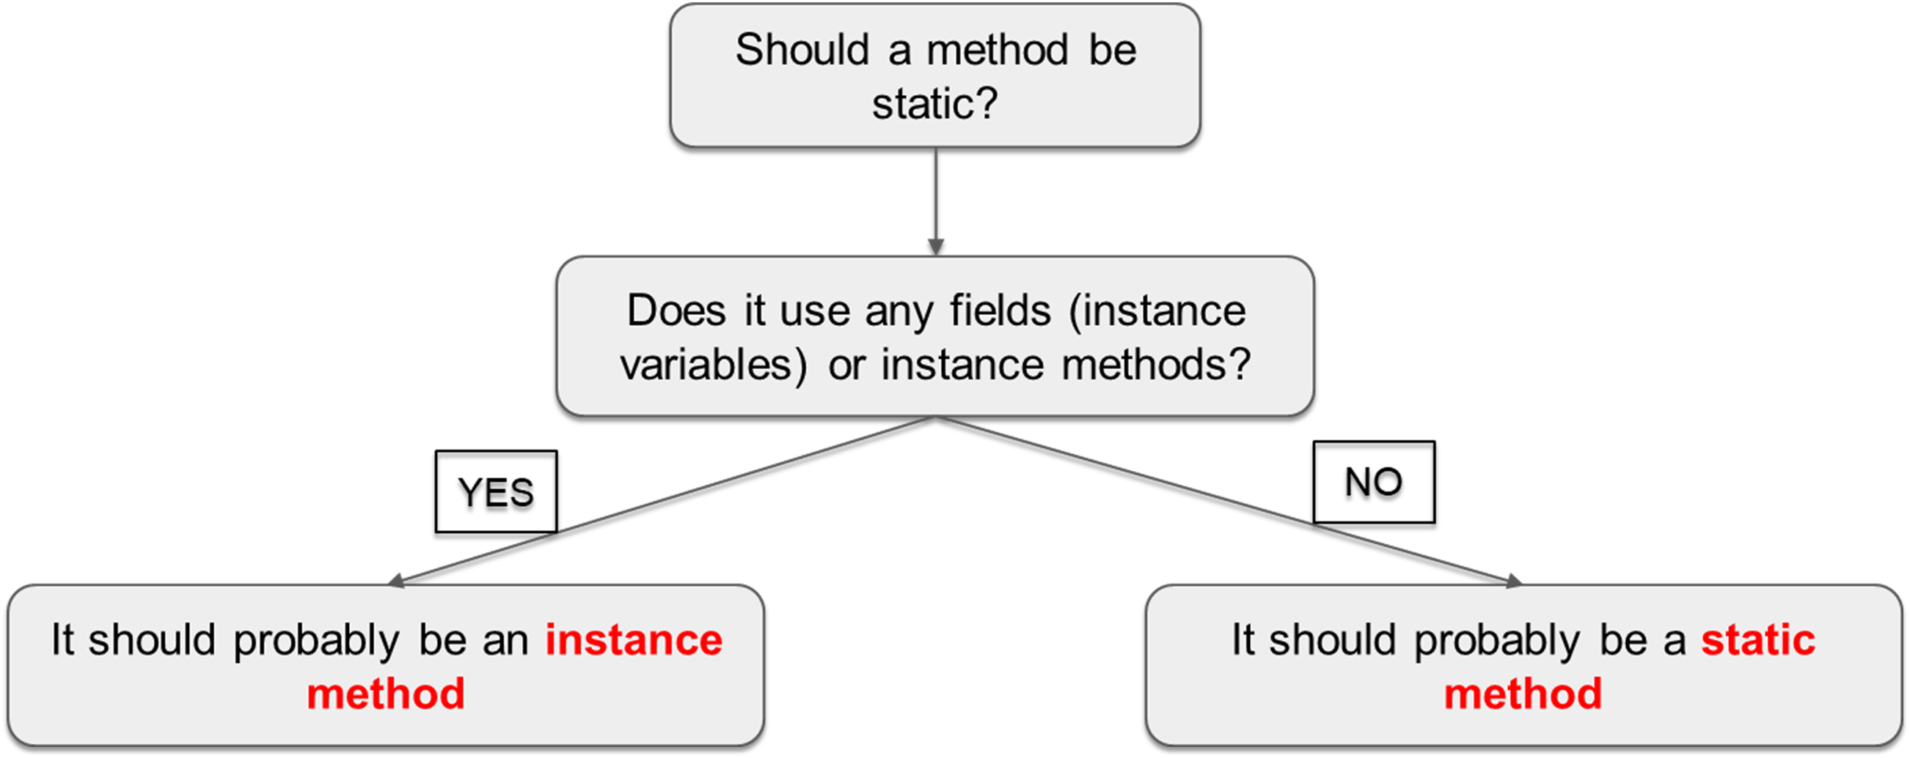
Static or Instance Method
COMPLETE JAVA MASTERCLASS
Static vs Instance Methods

